Slide 1
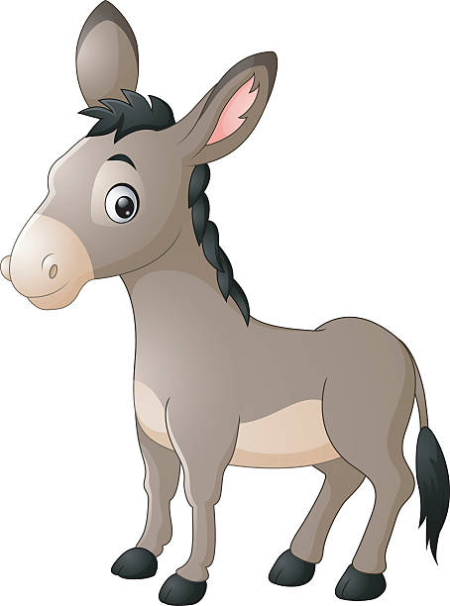
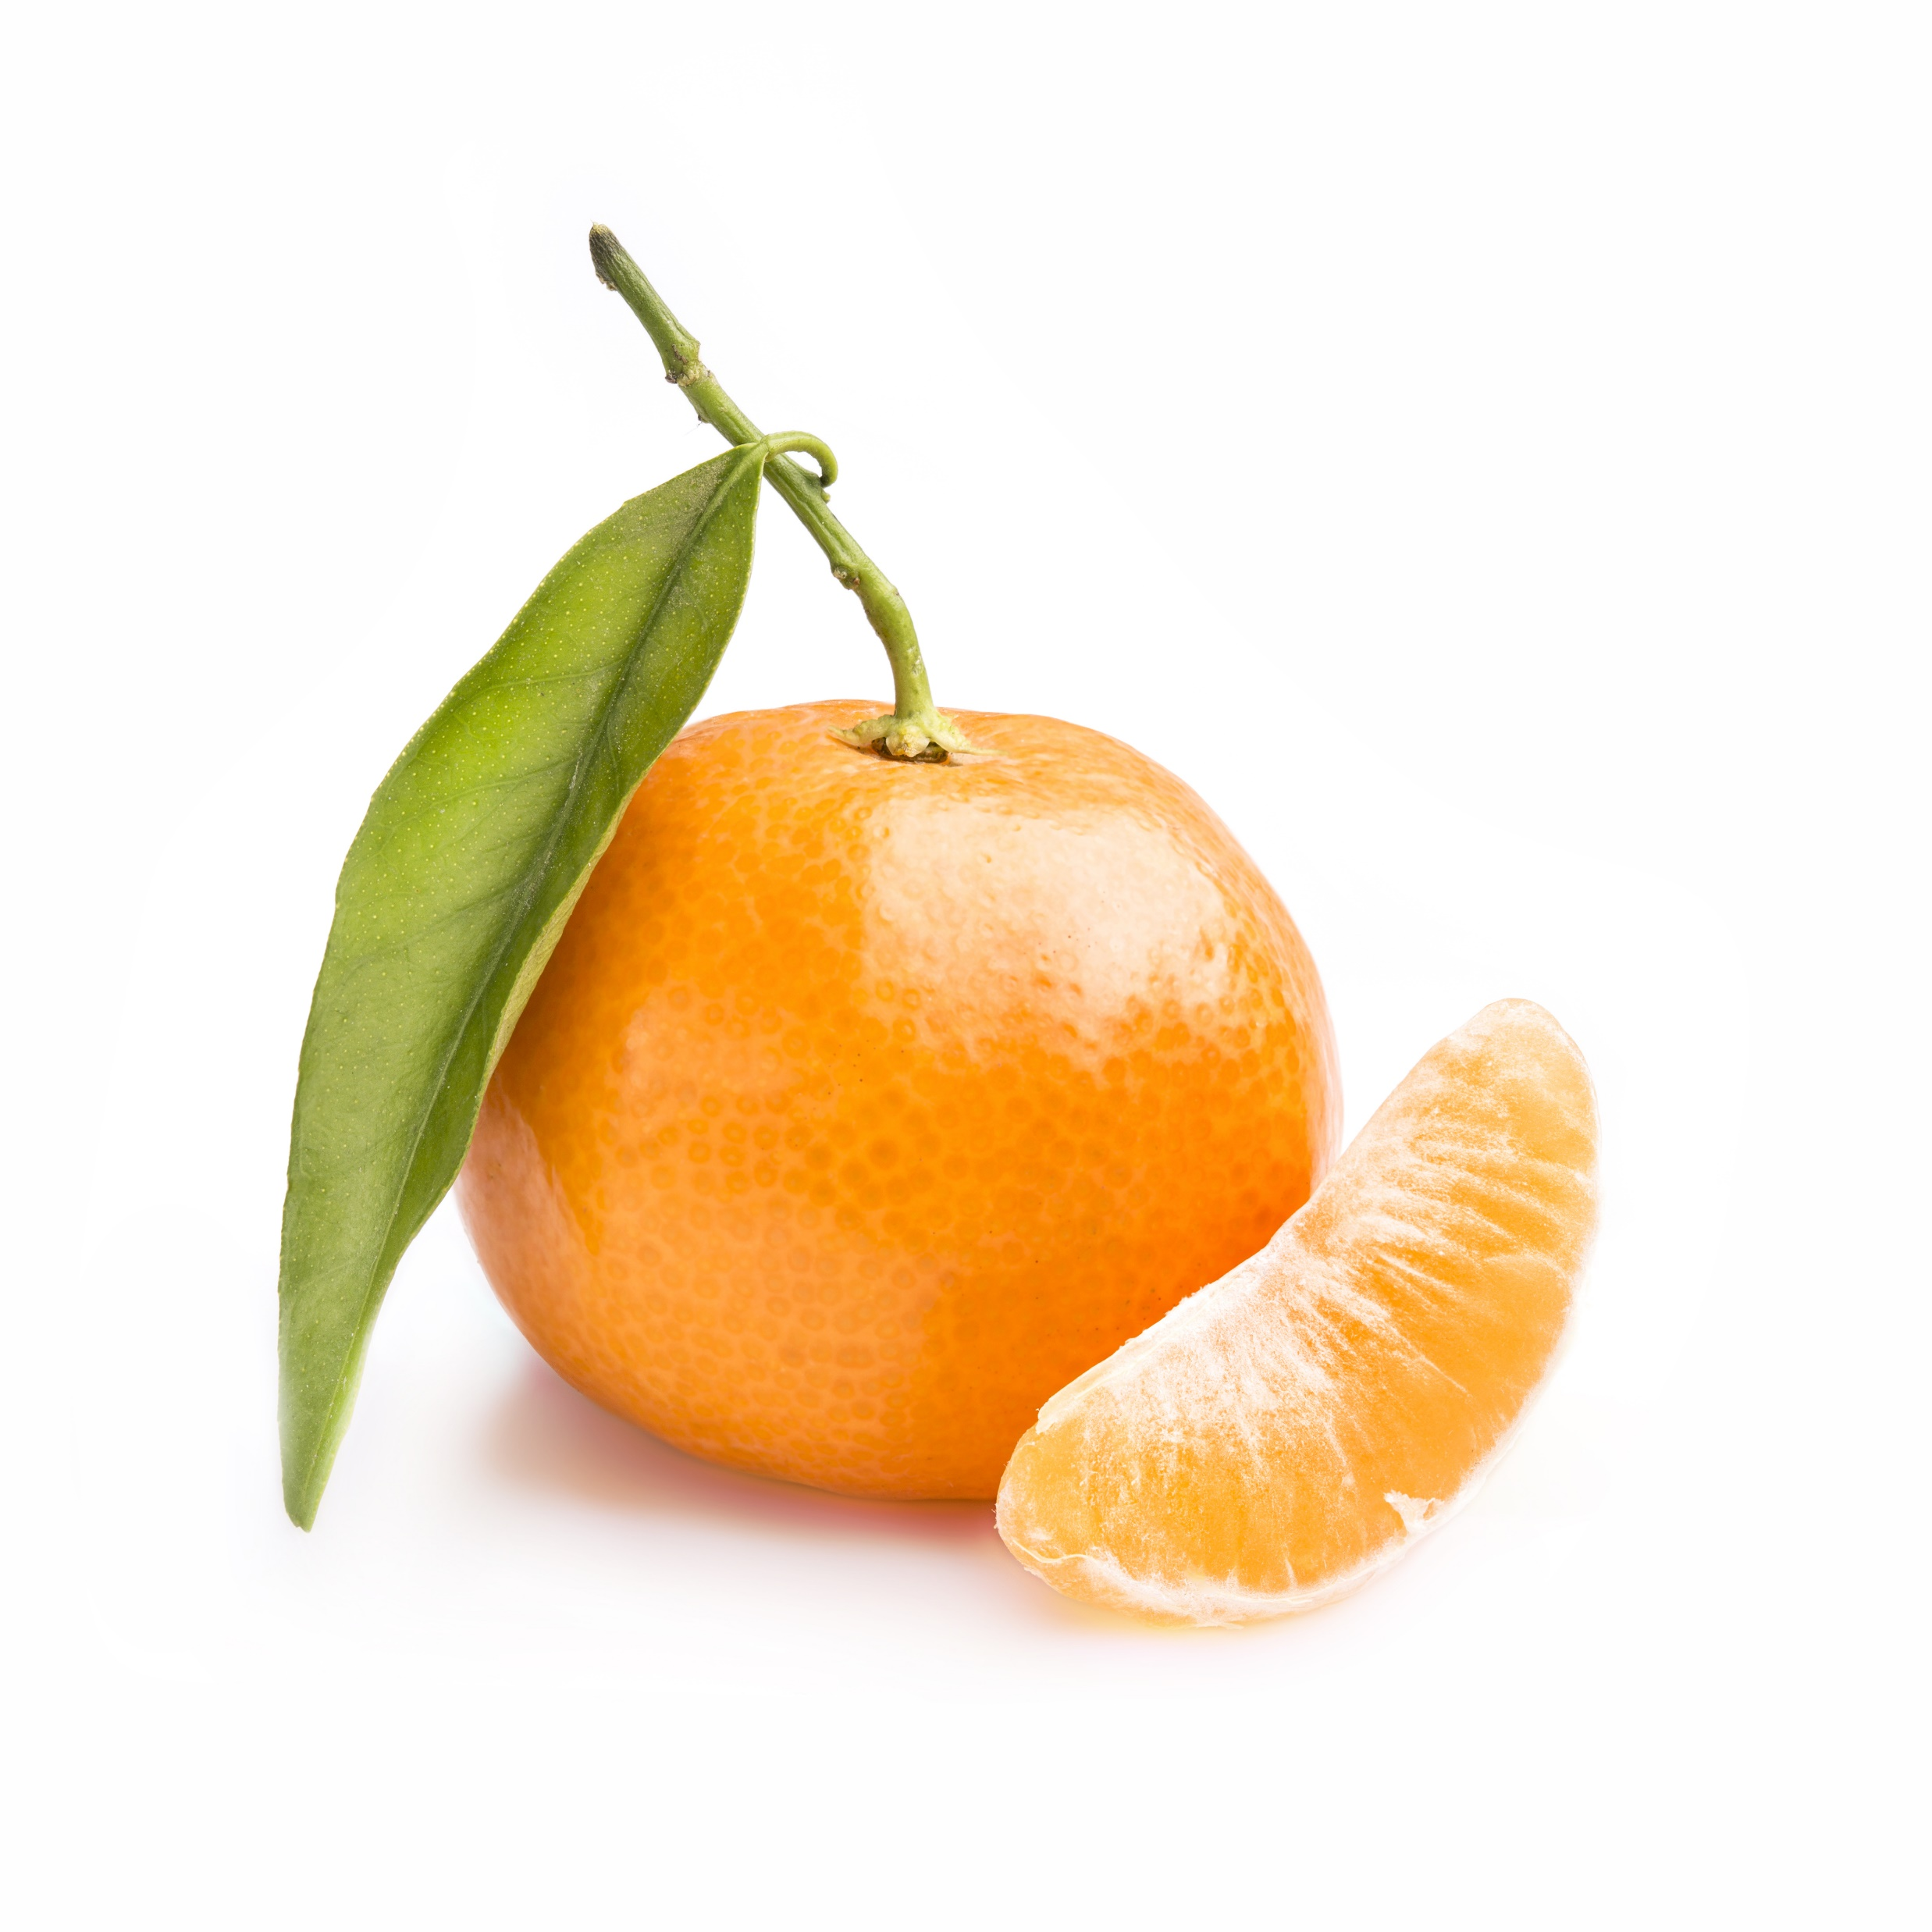
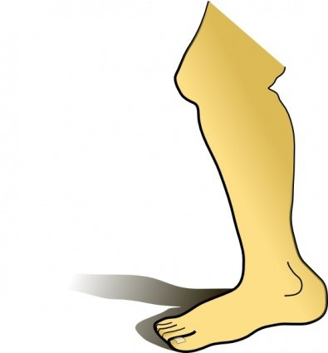
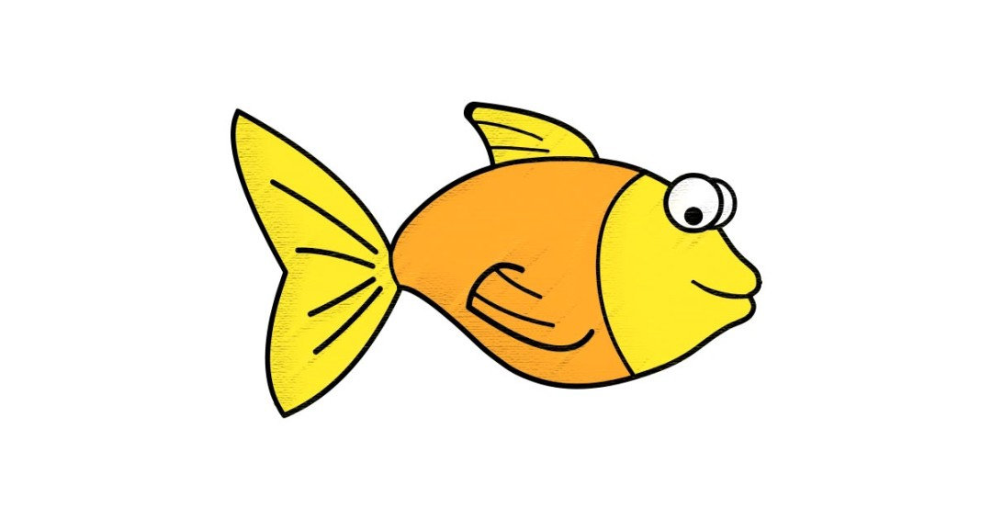
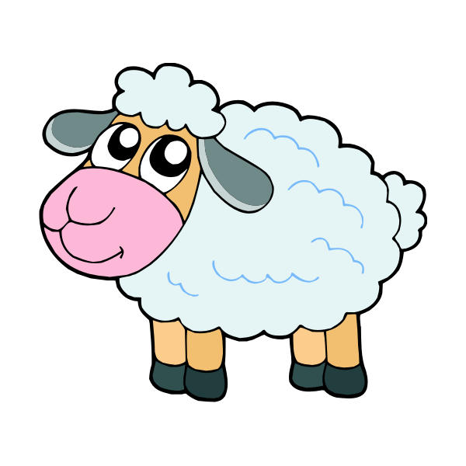
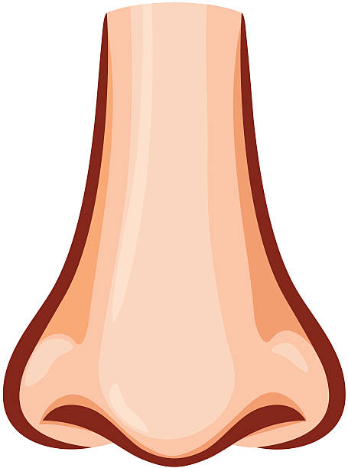
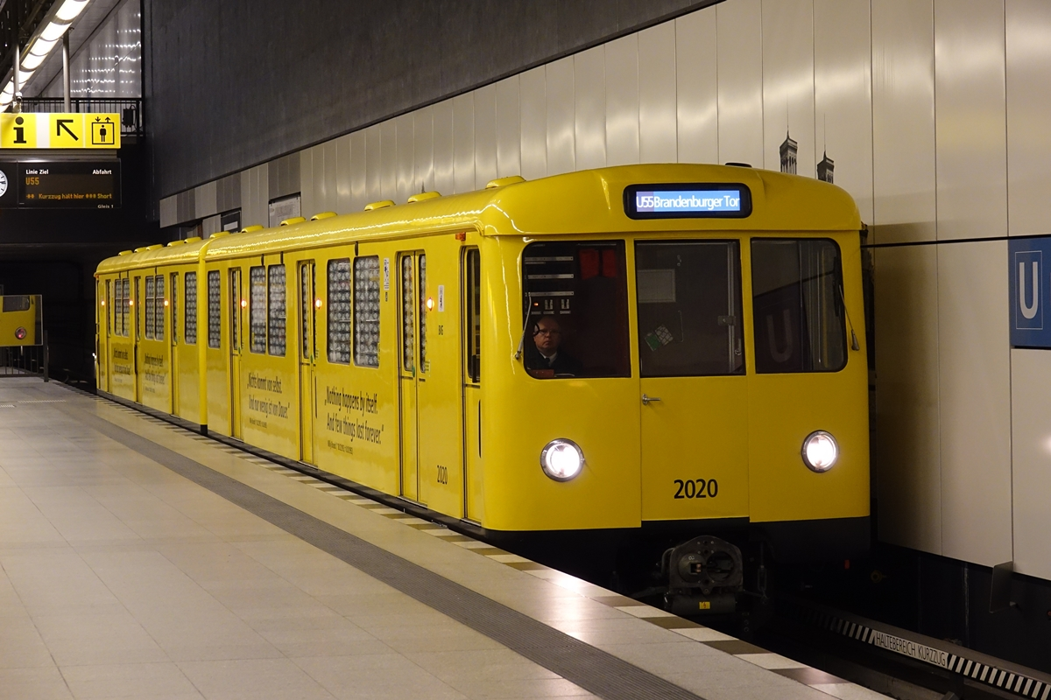
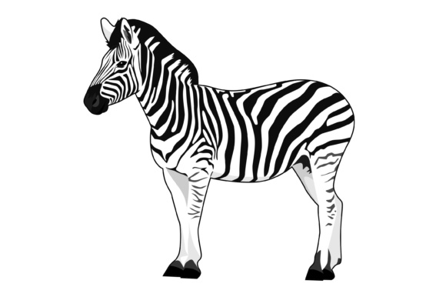
Apfel | B | Clementine | D | Esel
Fisch | G | Hahn | I | Jambe
K | L | Mouton | Nase | O
Pluie | Q | Regenbogen | S | T
Ubahn | V | W | X | Yeux
Zebra

Slide 2
6674976f796dc435ab39340f9fa97af2.jpg (630×630) (pinimg.com)
Clementine - Bing images
cartoon-happy-donkey-vector-id606739430 (454×612) (istockphoto.com)
Fish-Clipart-JPG-1080x565.jpg (1080×565) (graphiccave.com)
french-rooster-vector-id641085644 (411×421) (istockphoto.com)

Slide 3
nose-vector-id153453023 (455×612) (istockphoto.com)
leg-clip-art-44944.jpg (395×425) (clipart.me)
autocollant-mouton.jpg (600×600) (123-stickers.com)
cloud-37011_960_720.png (844×720) (pixabay.com)
292669-ein-schoner-regenbogen-auf-weissem-hintergrund-kostenlos-vektor.jpg (6306×3489) (vecteezy.com)
die-baureihe-d-mit-wagen-1008211.jpg (1200×800) (bahnbilder.de)

Slide 4
il_fullxfull.1278455265_kt17.jpg (1077×1077) (dtkp6g0samjql.cloudfront.net)
Zebra-Illustrations-by-graphicrun123-2-580x386.jpg (580×386) (creativefabrica.com)

